Slide 1
Introduction to
Fusion Part 2.
Steve Cowley,
PPPL

Slide 2
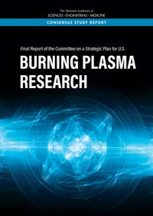
National Academy of Sciences calls for Pilot Plant by 2040/50
Community Planning Process 2019-20
High field compact
Designs from
MIT “SPARC” – “ARC”
And this Princeton
one shown in NAS
report.
High T_{c} at ~ 20⁰
Superconductors
~25T on coil
Tom Brown, Jon Menard PPPL
Notes:
Glib statement – wanted now.
Required late century – transition technologies.
National Climate assessment.

Slide 3
National Academy Review

Slide 4
Cost of plant – Simplistic Rule of Thumb
Empirical fit to the machines/experiments that have been built
Constants?
This formula results from the cost of engineering not
the cost of stuff (steel, tungsten, niobium etc.). I think it is misleading.
>60% of cost is from coils, power supplies, cryogenics
SIMPLICITY MATTERS
Must add the cost of Balance of Plant – in fission this is > 80% of the cost. It depends critically on the thermal output of the fusion system

Slide 5
Can we make it smaller and cheaper?
What sets the size?

Slide 6
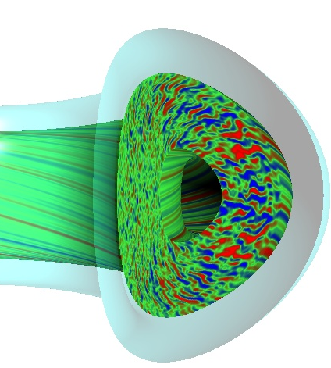
Energy Confinement -- Random walk of heat/particles.
N random turbulent steps to leave machine
Eddy size ρ_{i} – Larmor radius
V_{thi} = ion thermal velocity
See Saskia Mordijck’s lecture tomorrow
For ITER N ~ 10⁶.
Eddy turnover time =
Work at constant temperature the community
defines an enhancement factor H such that
R
Ignoring subtleties of the geometry

Slide 7
Burning
CONDITION TO BE SELF HEATED
H and beta depends on shape profiles etc. Physics!
SCALING FOR SELF SIMILAR TOKAMAKS

Slide 8
National Academy of Sciences calls for Pilot Plant by 2040/50
High field compact
Designs from
MIT “SPARC” – “ARC”
And this Princeton
one shown in NAS
report.
High T_{c} at ~ 20⁰
Superconductors
~25T on coil
SELF SIMILAR SCALING AT CONSTANT GAIN, ”H” AND SHAPE
ITER: R= 6.2m, B = 5.3T BR^{3/4} = 20.8
SPARC: R = 1.78m B = 12.5T BR^{3/4} = 19.2
Tom Brown, Jon Menard PPPL
Notes:
Glib statement – wanted now.
Required late century – transition technologies.
National Climate assessment.

Slide 9
Self Similar Power and Stored Energy
IGNITED DEVICE
FUSION POWER FROM DEVICE =
Total power essentially independent of size/field
Small high field devices have large heat fluxes
ENERGY STORED IN PLASMA:
Use scaling
Notes:
Glib statement – wanted now.
Required late century – transition technologies.
National Climate assessment.

Slide 10
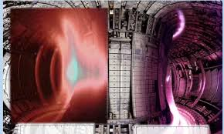
Disruption
Sometimes the plasma becomes unstable and deposits its energy on the wall
(often as relativistic electrons) this is called a disruption
Disruption energy per unit area of wall
Worse in smaller high field machines
Machine learning being used to predict the
Disruption and avoid it.
Most disruptions driven by the plasma current.
Notes:
Glib statement – wanted now.
Required late century – transition technologies.
National Climate assessment.

Slide 11
Or 3D? No Plasma Current.

Slide 12
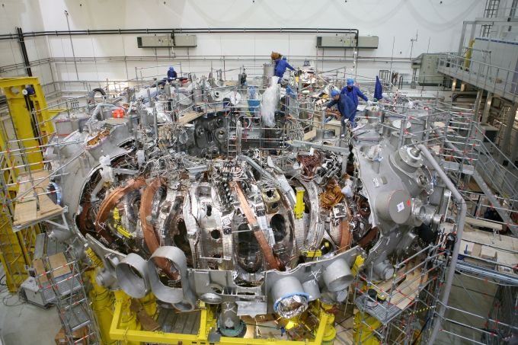
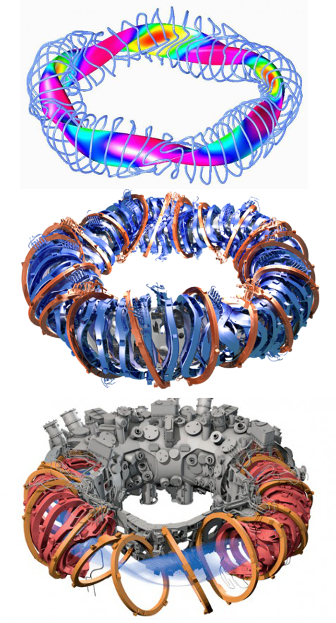
Stellarator – is 3D better?

Slide 13
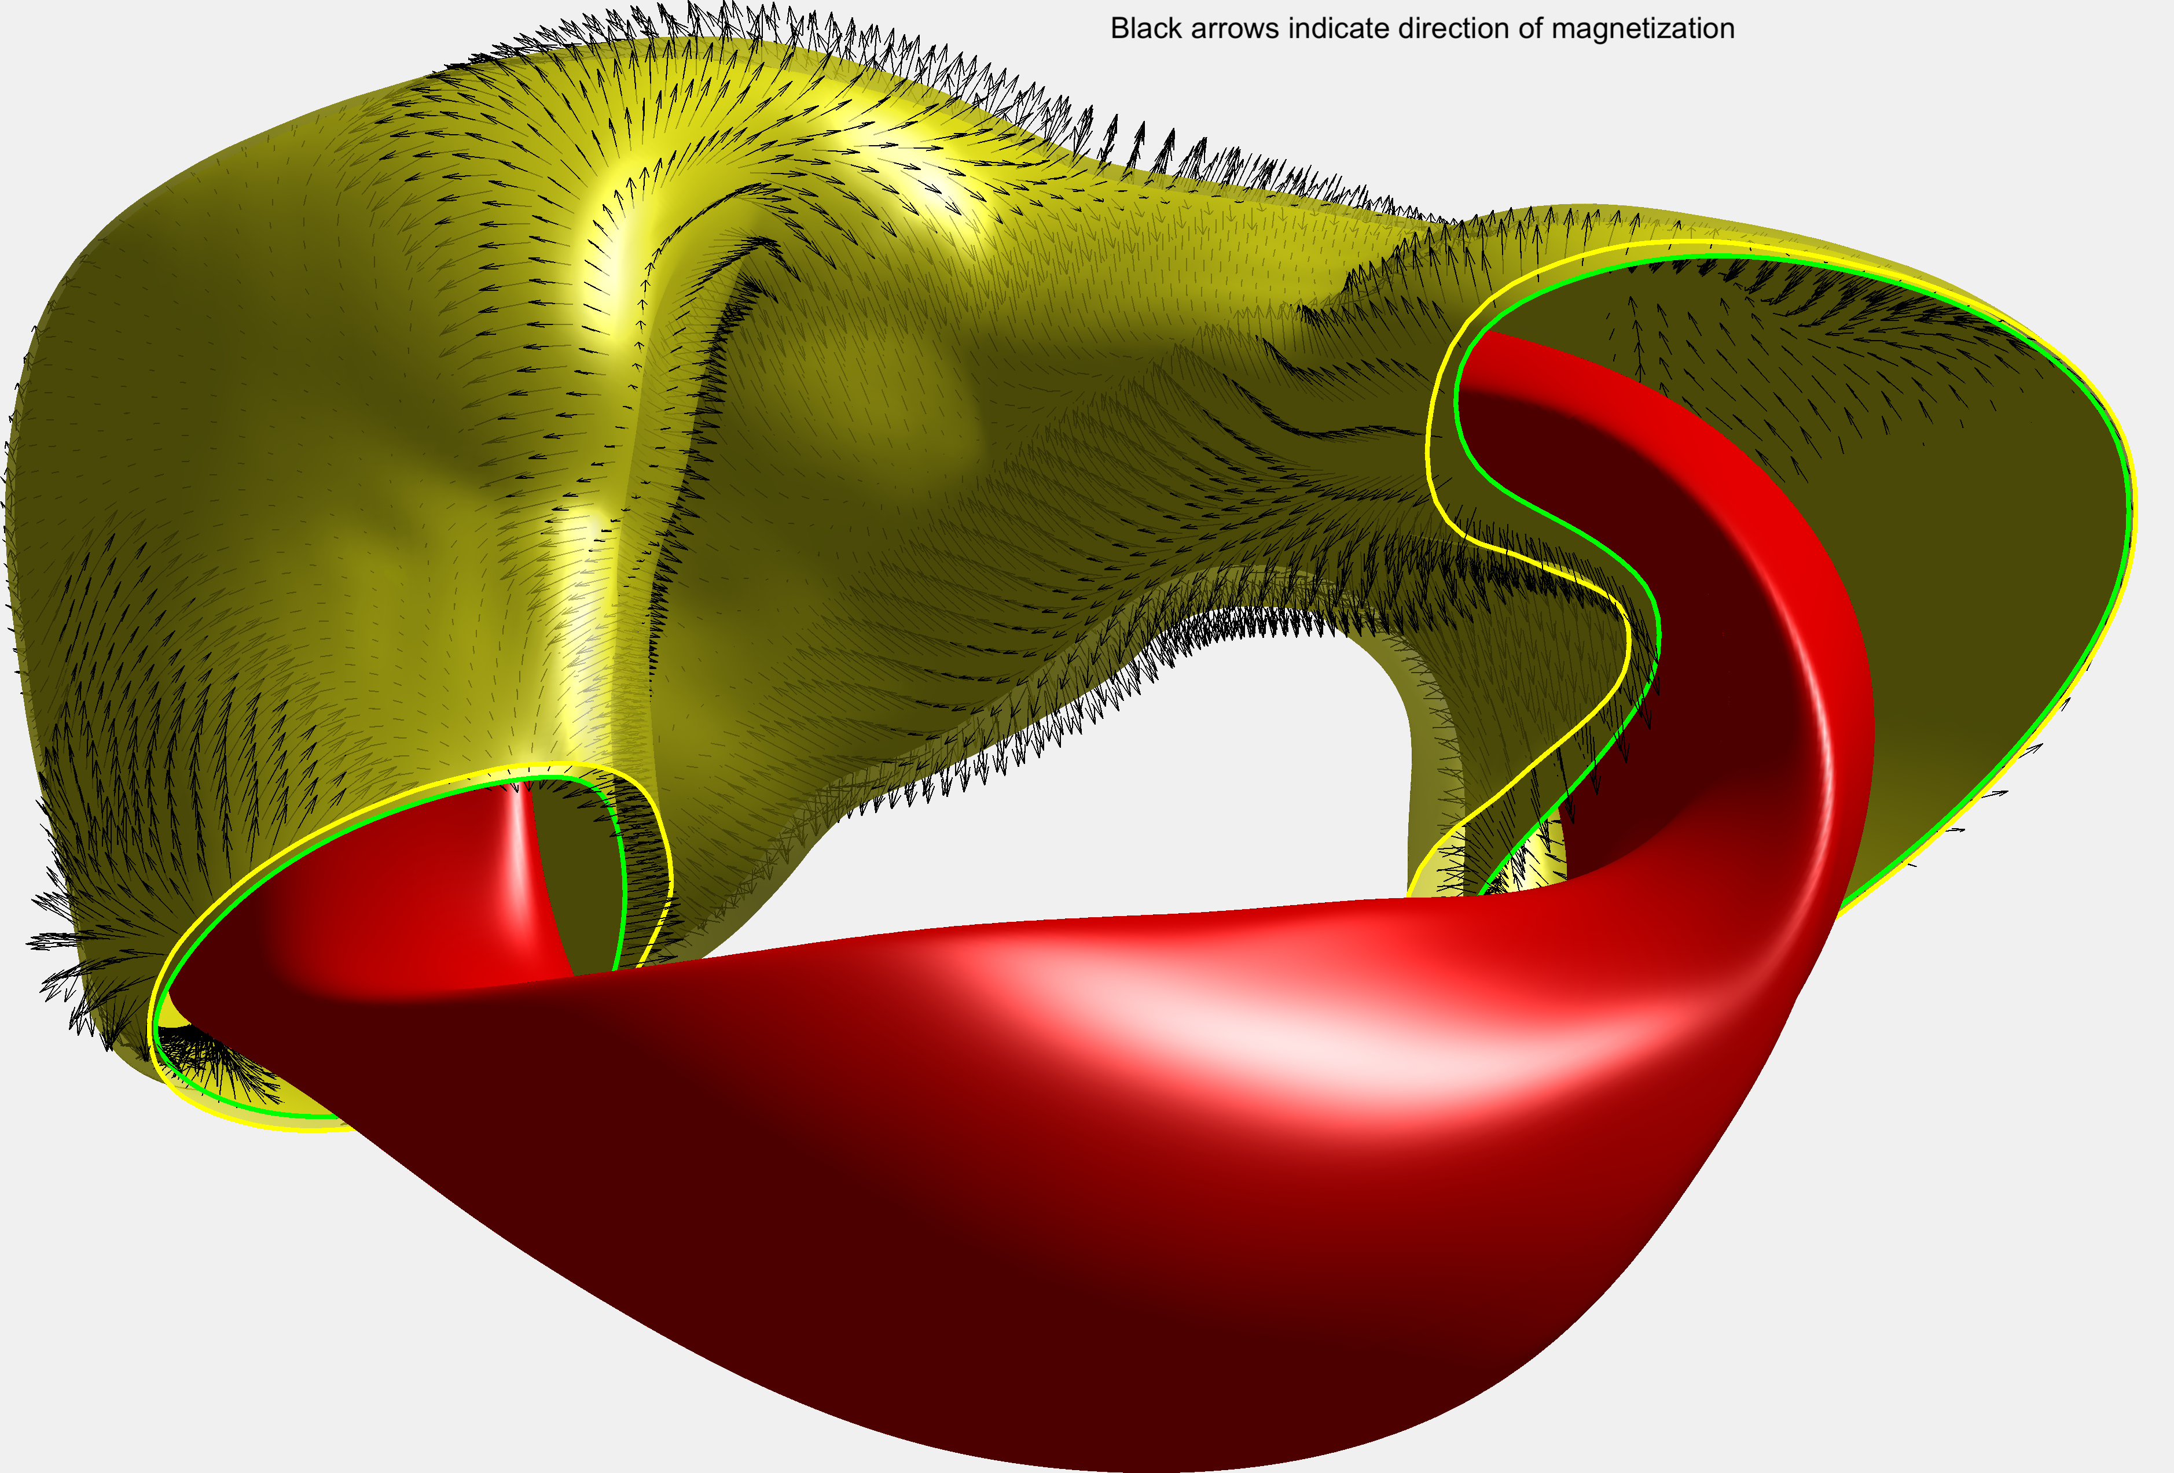
Innovation – permanent magnet stellarator – Gates, Zarnstorff, SC

Slide 14
Perfect Energy?
Safe, no waste legacy, abundant, minimal land use. But……
Development is not optional
We must push down the cost and scale if we are to get to market.

Slide 15
Thank you

